Slide 1
ZZG518 Database design and Applications Ms. Uma Maheswari

Slide 2
Session 4
LOGICAL Design

Slide 3
LEARNING OUTCOME
Mapping ER Constructs to relations
Mapping Class hierarchies
REFER: T1-Chapter 5
Sections:
5.1- 5.3

Slide 4
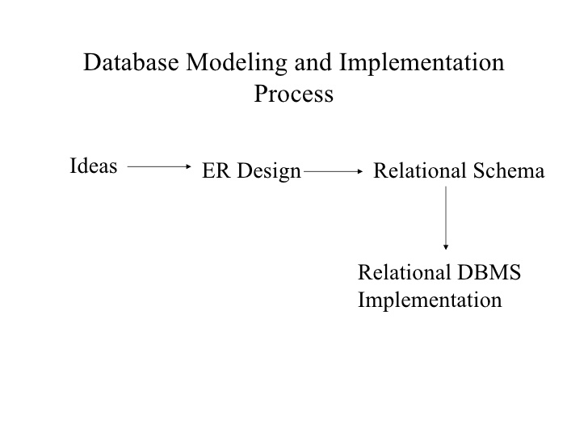
Database Modelling and Implementation Process
(Problem statement)

Slide 5
Mapping ER Constructs to relations

Slide 6
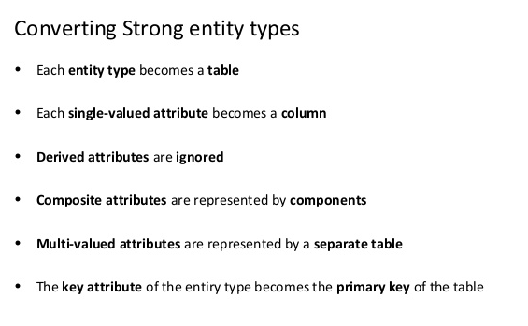
ER Constructs to relations

Slide 7
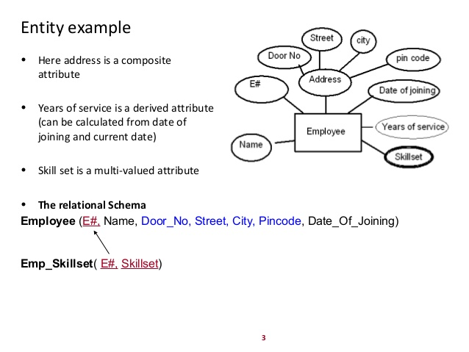
ER Constructs to relations

Slide 8
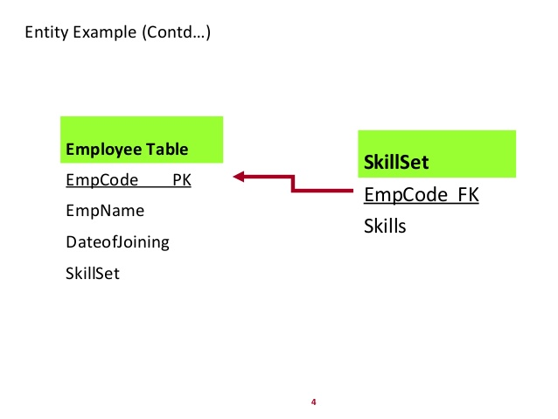
ER Constructs to relations

Slide 9
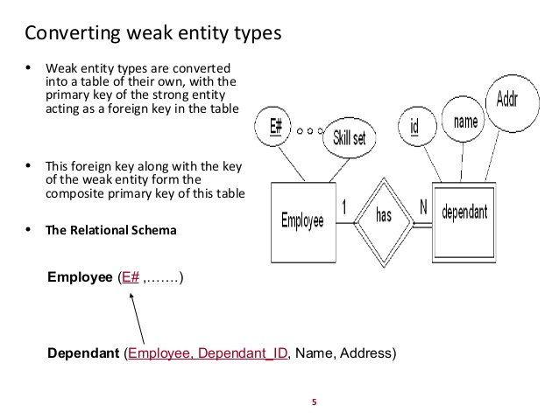
ER Constructs to relations

Slide 10
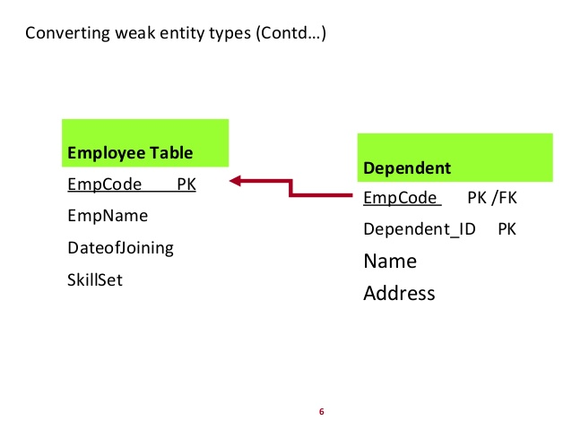
ER Constructs to relations

Slide 11
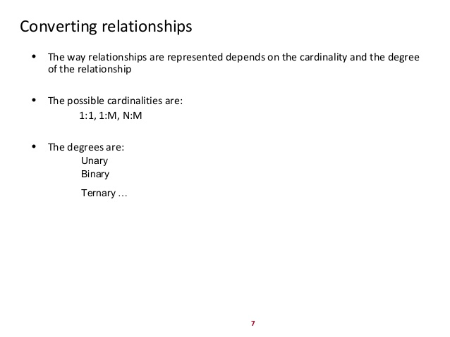
ER Constructs to relations

Slide 12
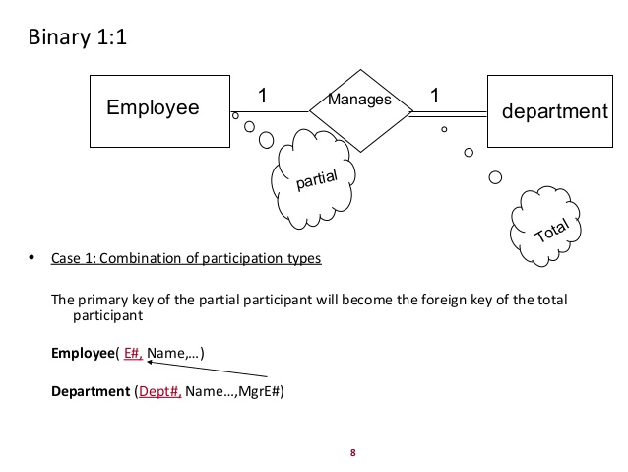
ER Constructs to relations

Slide 13
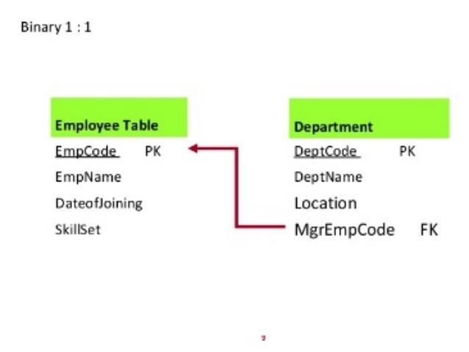
ER Constructs to relations

Slide 14
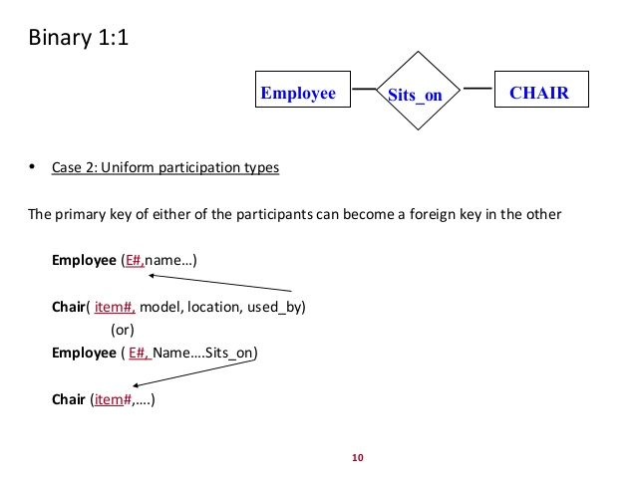
ER Constructs to relations

Slide 15
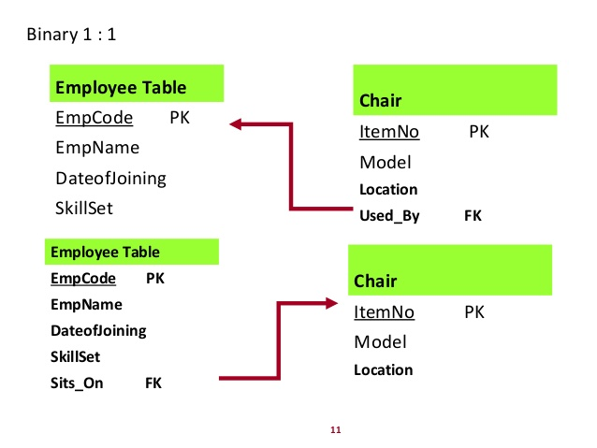
ER Constructs to relations

Slide 16
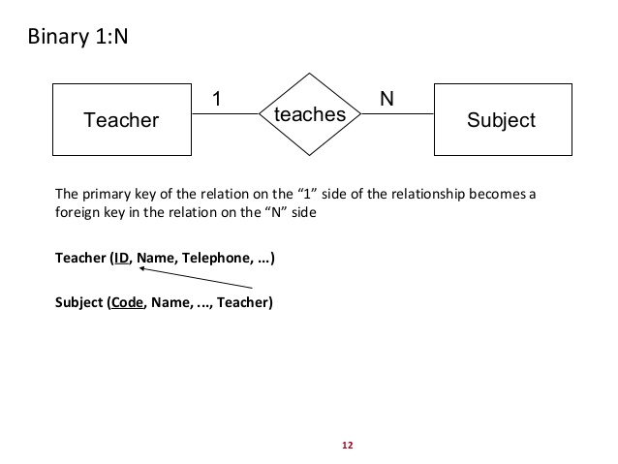
ER Constructs to relations

Slide 17
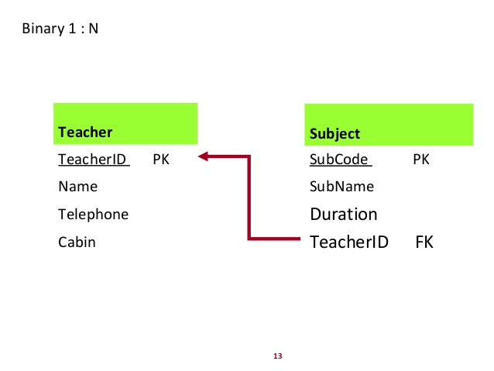
ER Constructs to relations

Slide 18
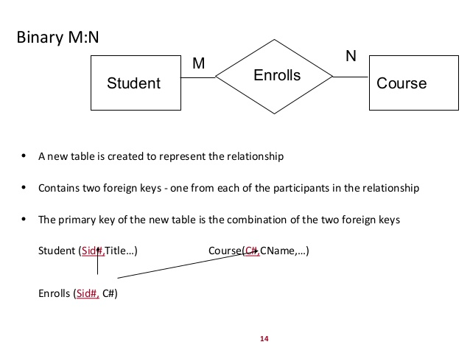
ER Constructs to relations

Slide 19
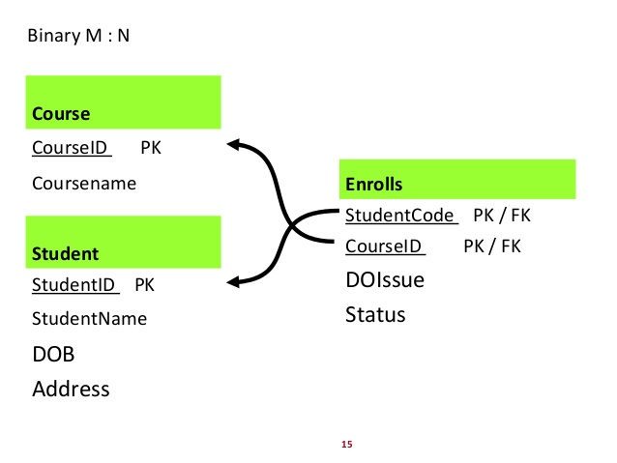
ER Constructs to relations

Slide 20
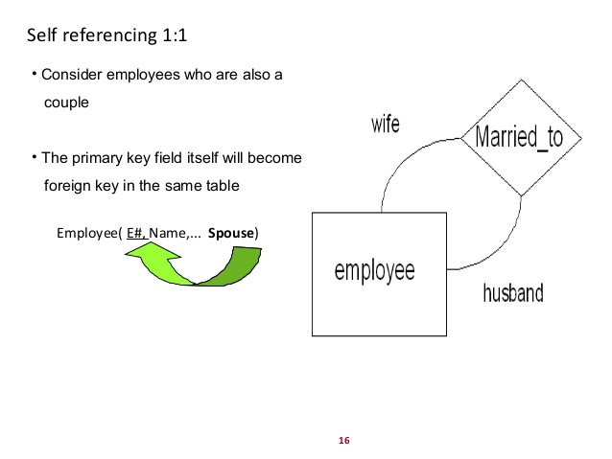
ER Constructs to relations

Slide 21
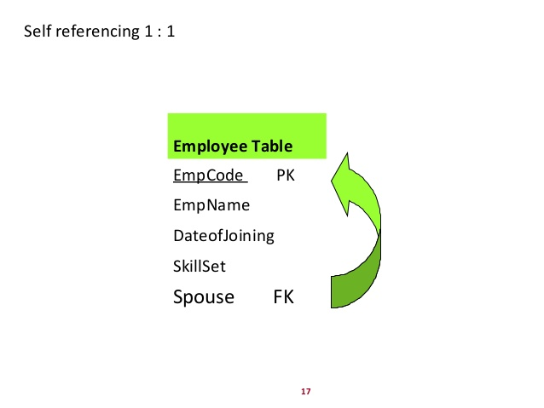
ER Constructs to relations

Slide 22
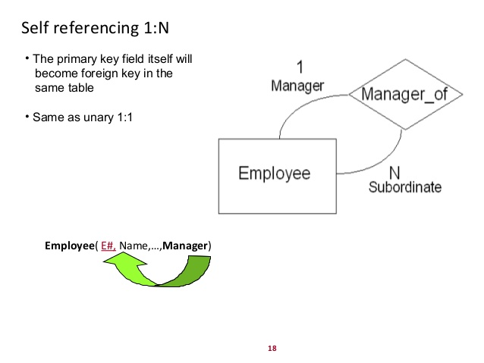
ER Constructs to relations

Slide 23
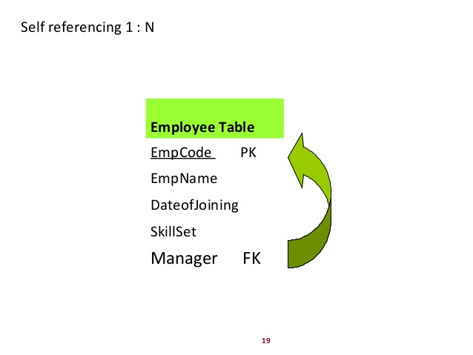
ER Constructs to relations

Slide 24
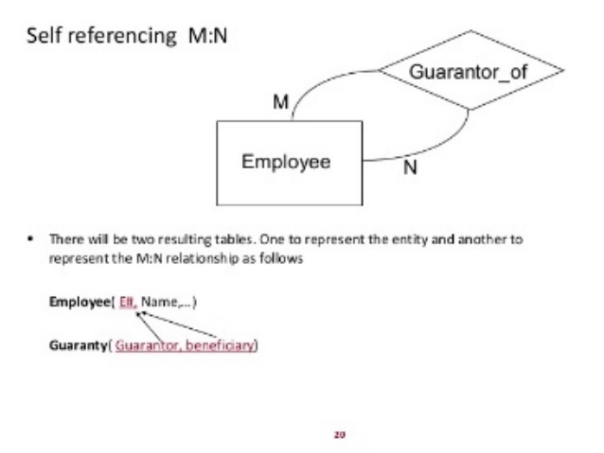
ER Constructs to relations

Slide 25
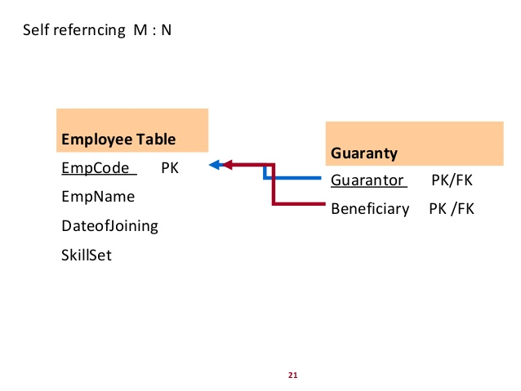
ER Constructs to relations

Slide 26
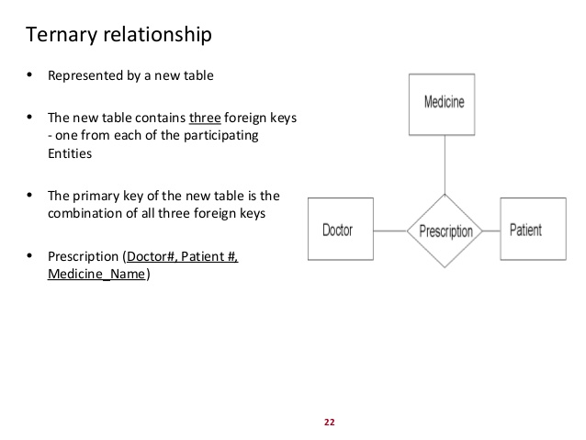
ER Constructs to relations

Slide 27
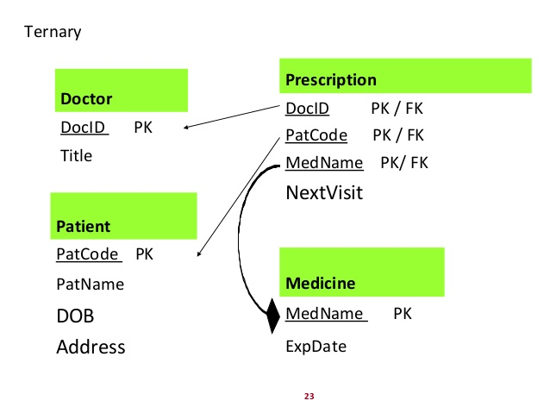
ER Constructs to relations

Slide 28
ER Constructs to relations
ER-to-Relational Mapping Algorithm
Step 1: Mapping of Regular Entity Types
Step 2: Mapping of Weak Entity Types
Step 3: Mapping of Binary 1:1 Relation Types
Step 4: Mapping of Binary 1:N Relationship Types.
Step 5: Mapping of Binary M:N Relationship Types.
Step 6: Mapping of Multivalued attributes.
Step 7: Mapping of N-ary Relationship Types.
Mapping EER Model Constructs to Relations
Step 8: Options for Mapping Specialization or Generalization.
Step 9: Mapping of Union Types (Categories).

Slide 29
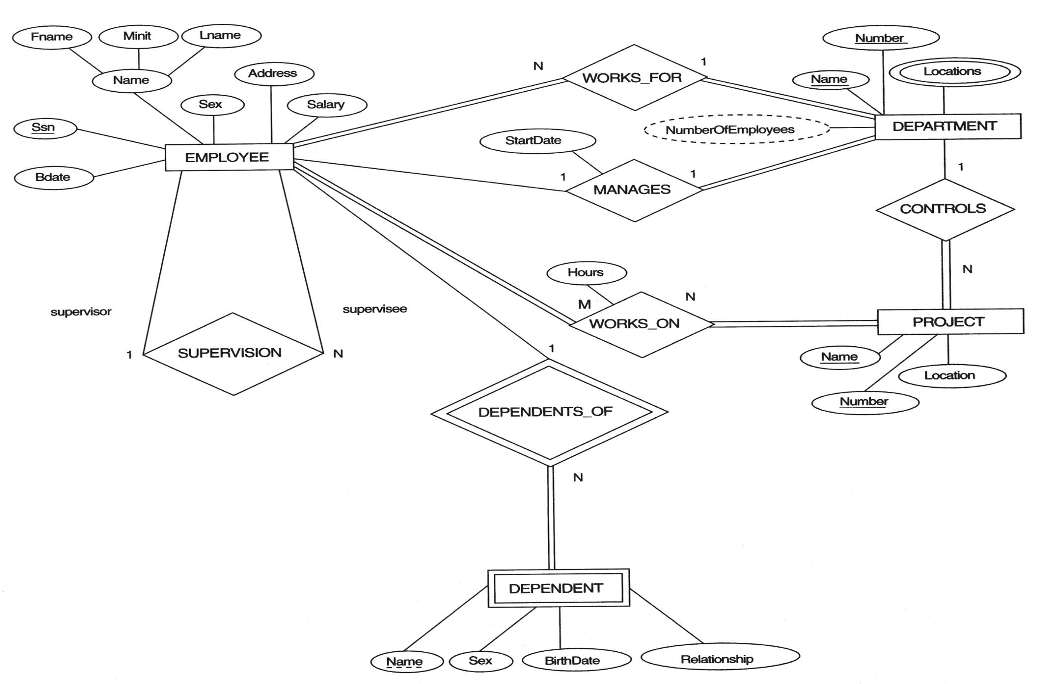
ER Constructs to relations
FIGURE 7.1 The ER conceptual schema diagram for the COMPANY database.

Slide 30
ER-to-Relational Mapping Steps
Step 1: Mapping of Regular Entity Types.
For each regular (strong) entity type in the ER schema, create a relation R that includes all the simple attributes of E.
Choose one of the key attributes of E as the primary key for the relation.
If the chosen key of E is a composite, then the set of simple attributes that form it will together form the primary key of R.
Example:
We create the relations EMPLOYEE, DEPARTMENT, and PROJECT in the relational schema corresponding to the regular entities in the ER diagram.
SSN, DNUMBER, and PNUMBER are the primary keys for the relations EMPLOYEE, DEPARTMENT, and PROJECT as shown.

Slide 31
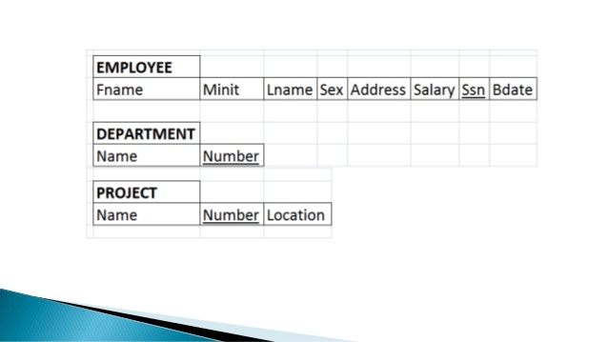
ER-to-Relational Mapping Steps

Slide 32
ER-to-Relational Mapping Steps
Step 2: Mapping of Weak Entity Types
For each weak entity type W in the ER schema with owner entity type E, create a relation R and include all attributes of the weak entity as attributes of the new relation R.
Then, include the primary key of the owner entity as foreign key attributes of R.
The primary key of R is the combination of the primary key(s) of the owner(s) and the partial key of the weak entity type W, if any.
Example:
Create the relation DEPENDENT in this step to correspond to the weak entity type DEPENDENT. Include the primary key SSN of the EMPLOYEE relation as a foreign key attribute of DEPENDENT (renamed to ESSN).
The primary key of the DEPENDENT relation is the combination {ESSN, DEPENDENT_NAME} because DEPENDENT_NAME is the partial key of DEPENDENT.

Slide 33
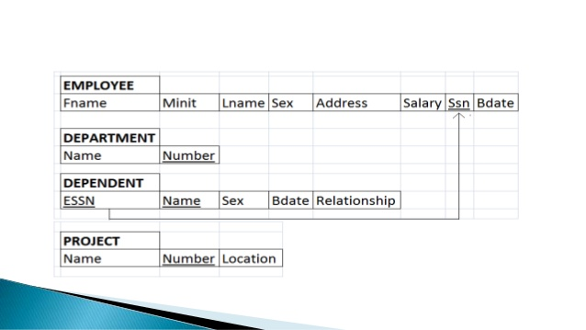
ER-to-Relational Mapping Steps

Slide 34
ER-to-Relational Mapping Steps
Step 3: Mapping of 1:1 Relation Types
For each 1:1 relationship type identify the entities participating in the relationship. There are two possible approaches below:
(1) Foreign Key approach:
Choose one of the relations and include a foreign key in one relation (S) which is the primary key of the other relation (T). It is better to choose an entity type with total participation in the relationship in the role of S.
Example: 1:1 relation MANAGES is mapped by choosing the participating entity type DEPARTMENT to serve in the role of S, because its participation in the MANAGES relationship type is total.
(2) Merged relation option:
An alternate mapping of a 1:1 relationship type is possible by merging the two entity types and the relationship into a single relation. This may be appropriate when both participations are total.
(3) Cross-reference or relationship relation approach: The third option is to set up a third relation R for the purpose of cross-referencing the primary keys of the two relations S and T representing the entity types.

Slide 35
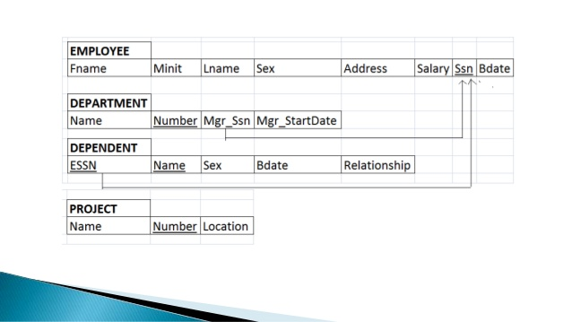
ER-to-Relational Mapping Steps

Slide 36
ER-to-Relational Mapping Steps
Step 4: Mapping of Binary 1:N Relationship Types.
For each regular 1:N relationship type R, identify the relation S, which is the entity on the N-side of the relationship.
Include as foreign key in S the primary key of the relation which is on the 1 side of the relationship.
Include any simple attributes of the 1:N relation type as attributes of S.
Example:
1:N relationship types WORKS_FOR, CONTROLS, and SUPERVISION in the figure. For WORKS_FOR we include the primary key DNUMBER of the DEPARTMENT relation as foreign key in the EMPLOYEE relation and call it DNO.

Slide 37
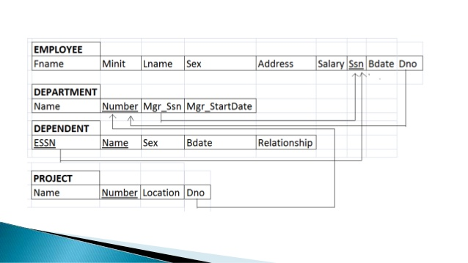
ER-to-Relational Mapping Steps

Slide 38
ER-to-Relational Mapping Steps
Step 5: Mapping of Binary M:N Relationship Types.
For each M:N relationship type, create a new relation S to represent the relationship.
Include as foreign key attributes in S the primary keys of the entities on each side of the relationship; the combination of the two primary keys will form the primary key of S.
Also include any simple attributes of the M:N relationship type(or simple components of composite attributes) as attributes of S.
Example:
The M:N relationship type WORKS_ON from the ER diagram is mapped by creating a relation WORKS_ON in the relational database schema. The primary keys of the PROJECT and EMPLOYEE relations are included as foreign keys in WORKS_ON and renamed PNO and ESSN, respectively.
Attribute HOURS in WORKS_ON represents the HOURS attribute of the relation type. The primary key of the WORKS_ON relation is the combination of the foreign key attributes {ESSN, PNO}.

Slide 39
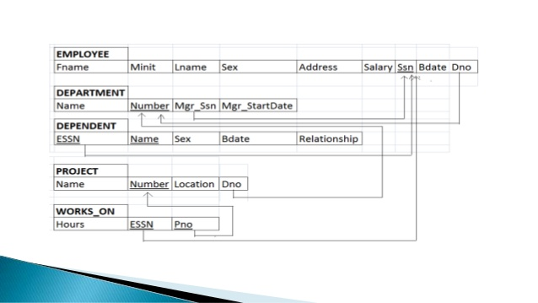
ER-to-Relational Mapping Steps

Slide 40
ER-to-Relational Mapping Steps
Step 6: Mapping of Multivalued attributes.
For each multivalued attribute A, create a new relation R.
This relation R will include an attribute corresponding to A, plus the primary key attribute K—as a foreign key in R—of the relation that represents the entity type or relationship type that has A as a multivalued attribute.
The primary key of R is the combination of A and K. If the multivalued attribute is composite, we include its simple components.
Example:
The relation DEPT_LOCATIONS is created. The attribute DLOCATION represents the multivalued attribute LOCATIONS of DEPARTMENT, while DNUMBER-as foreign key-represents the primary key of the DEPARTMENT relation. The primary key of R is the combination of {DNUMBER, DLOCATION}.

Slide 41
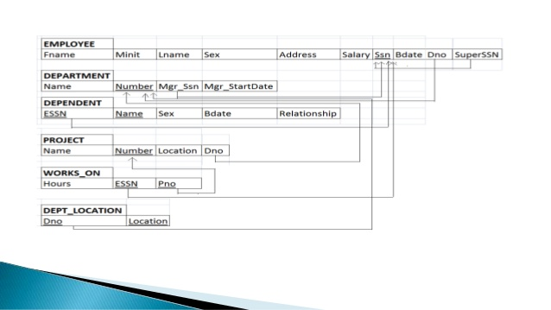
ER-to-Relational Mapping Steps

Slide 42
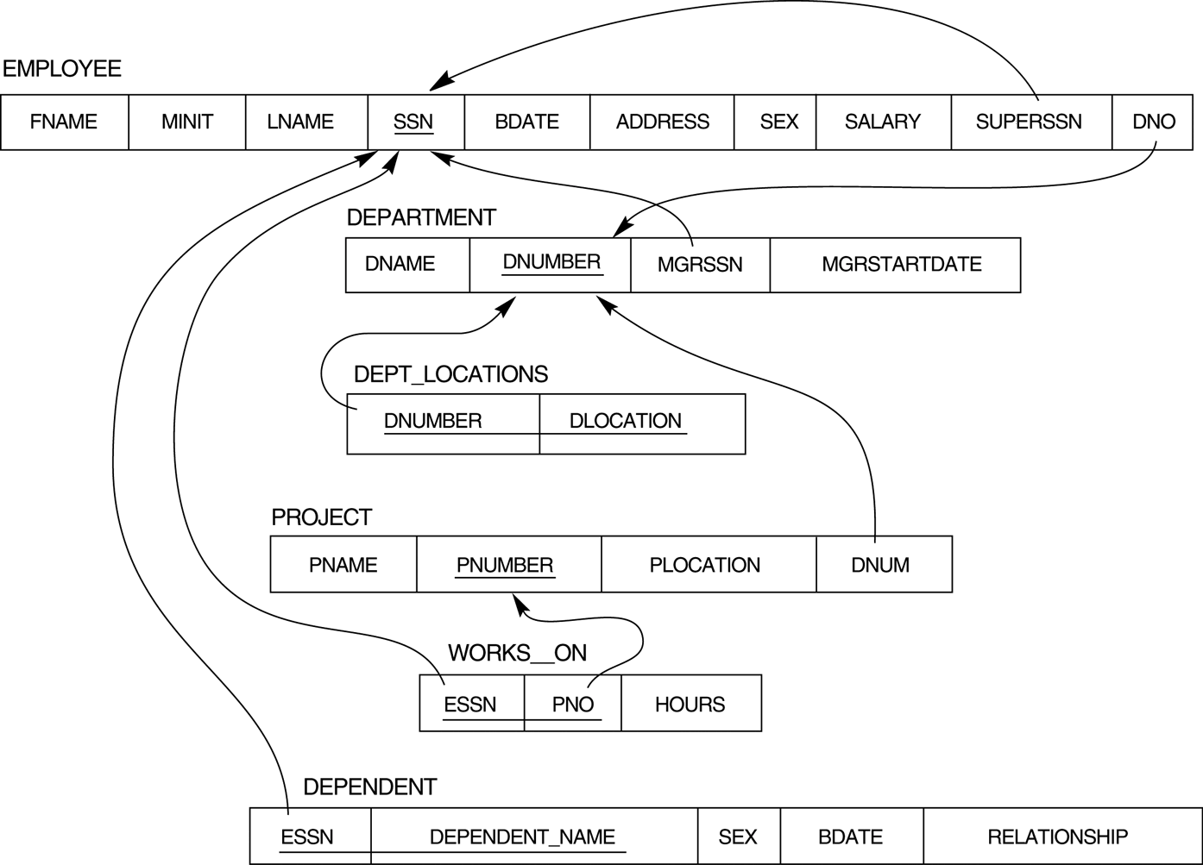
ER-to-Relational Mapping Steps
FIGURE 7.2 Result of mapping the COMPANY ER schema into a relational schema.

Slide 43
ER-to-Relational Mapping Steps
Step 7: Mapping of N-ary Relationship Types. (Non-binary relationships)
For each n-ary relationship type R, where n > 2, create a new relation S to represent R.
Include as foreign key attributes in S the primary keys of the relations that represent the participating entity types.
Also include any simple attributes of the n-ary relationship type (or simple components of composite attributes) as attributes of S.
Example:
The relationship type SUPPY in the ER on the next slide. This can be mapped to the relation SUPPLY shown in the relational schema, whose primary key is the combination of the three foreign keys {SNAME, PARTNO, PROJNAME}

Slide 44
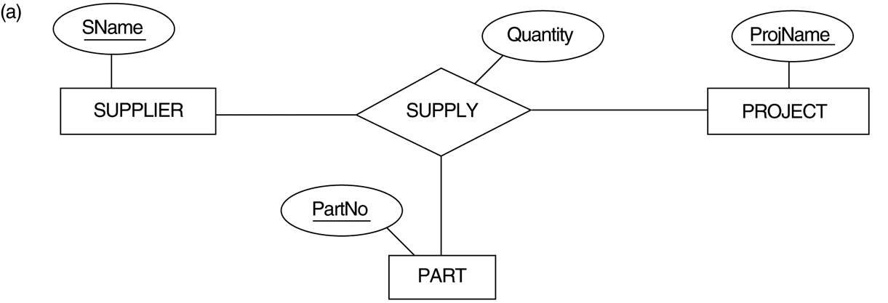
ER-to-Relational Mapping Steps
FIGURE 4.11 Ternary relationship types. (a) The SUPPLY relationship.

Slide 45
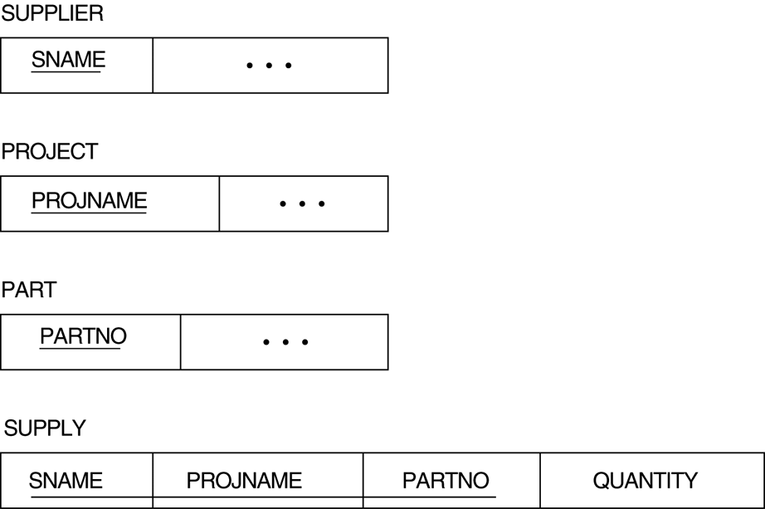
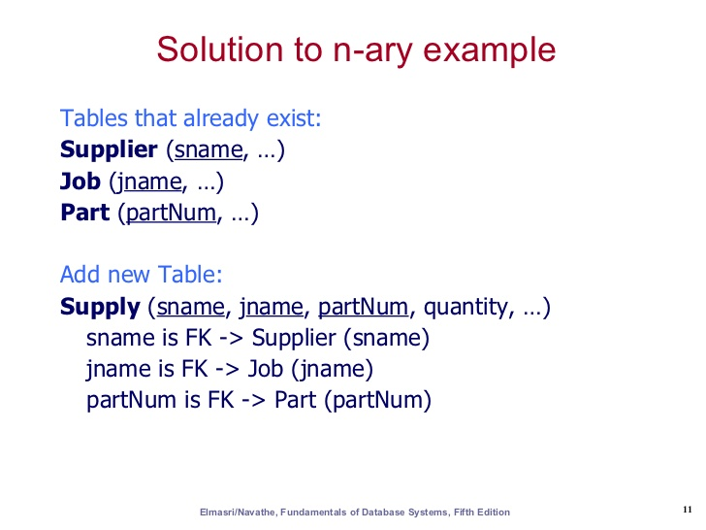
ER-to-Relational Mapping Steps
FIGURE 7.3 Mapping the n-ary relationship type SUPPLY from Figure 4.11a.

Slide 46
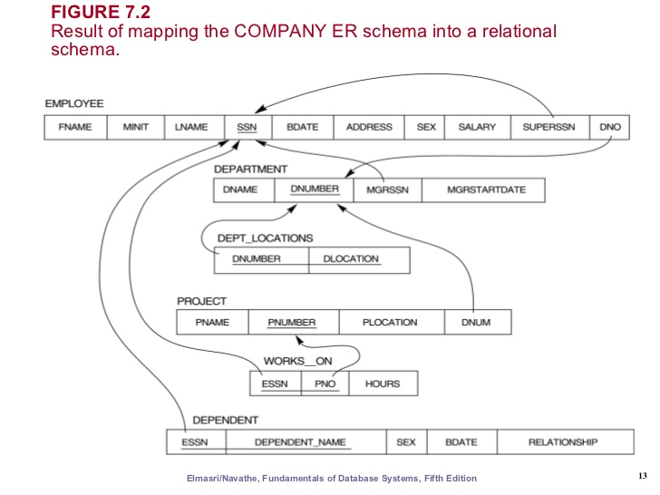
ER-to-Relational Mapping Steps

Slide 47
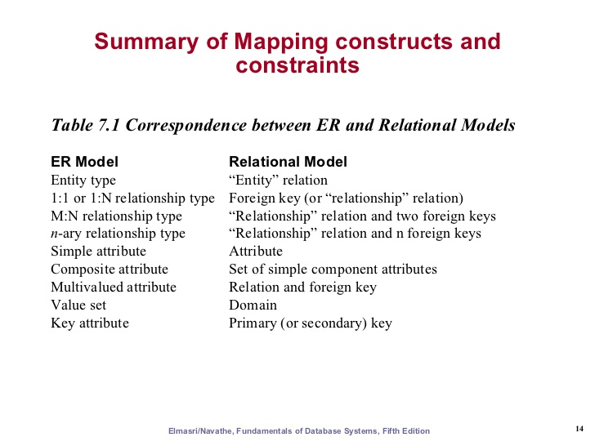
ER-to-Relational Mapping Steps

Slide 48
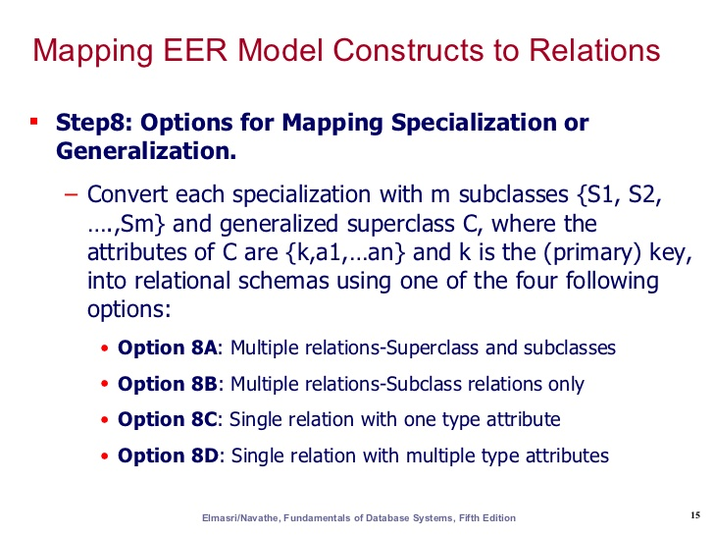
ER-to-Relational Mapping Steps

Slide 49
EER-to-Relational Mapping Steps
Step8: Options for Mapping Specialization or Generalization.
Option 8A: Multiple relations, Super class and subclasses.
Create a relation for the super class, including the super class attributes.
Create a relation for each subclass, which includes the primary key of the super class (which acts as the foreign key) and the attributes of the subclass specialization.
This works for any specialization (partial, total, disjoint, overlapping)
Option 8B: Multiple relations, Subclass relations only
Create a relation for each subclass, with the attributes of both the super class and the attributes of the subclass.
This only works for total specializations, meaning that every entity in the super class must belong to at least one subclass. Otherwise members of the super class that don’t belong to a subclass will not be represented.

Slide 50
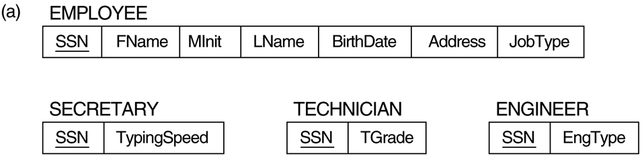
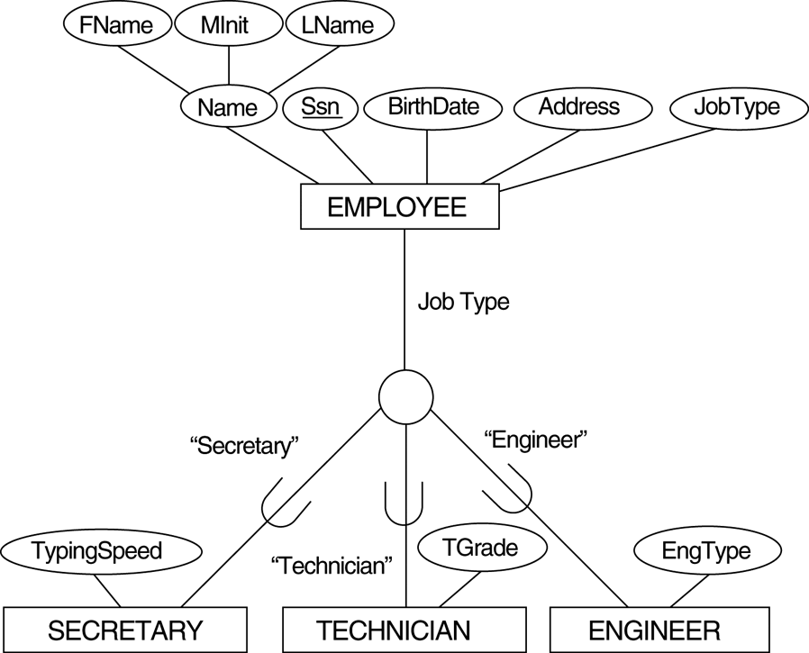
EER-to-Relational Mapping Steps
FIGURE 7.4 – Using Option 8A

Slide 51
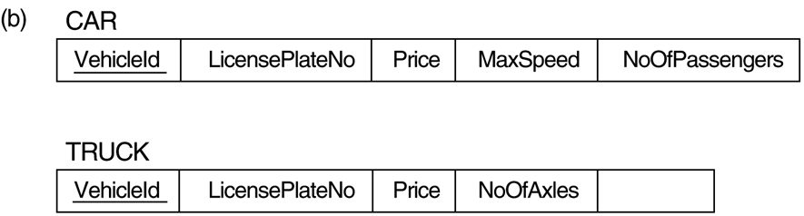
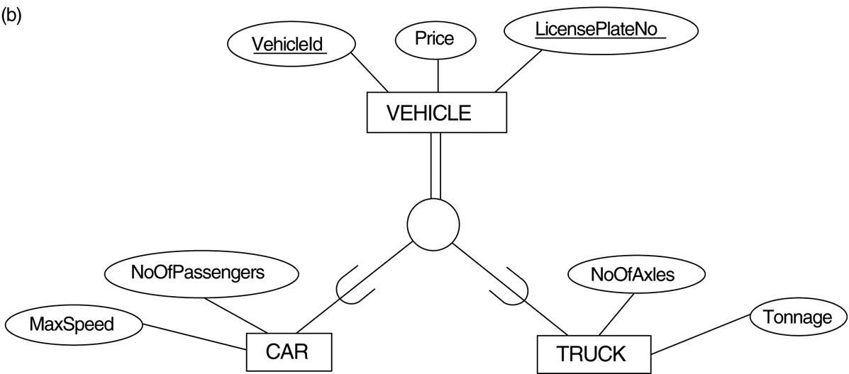
EER-to-Relational Mapping Steps
Tonnage
FIGURE 7.4 – Using Option 8B

Slide 52
EER-to-Relational Mapping Steps
Option 8C: Single relation with one type attribute.
Create a single relation, with all the attributes of the super class and all the attributes of a subclass.
Include a ‘Type’ attribute, which is the discriminating attribute which indicates which subclass the row belongs to.
This only works if the specialization is disjoint, meaning the super class entity cannot be a member of more than one subclass.
Option 8D: Single relation with multiple type attributes.
Create a single relation with all the attributes of the super class and all the attributes of the subclass.
Include a Boolean “Type” attribute for each subclass, which indicates whether the row belongs to that subclass.
This works with overlapping specializations, to indicate if the super class entity belongs to more than one subclass.

Slide 53
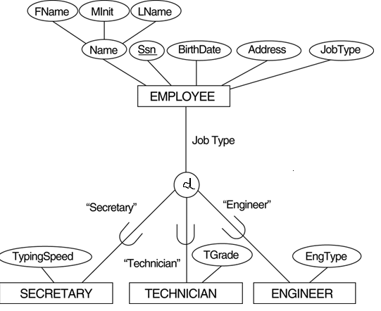
EER-to-Relational Mapping Steps
EngType
FIGURE 7.4 – Using Option 8C

Slide 54
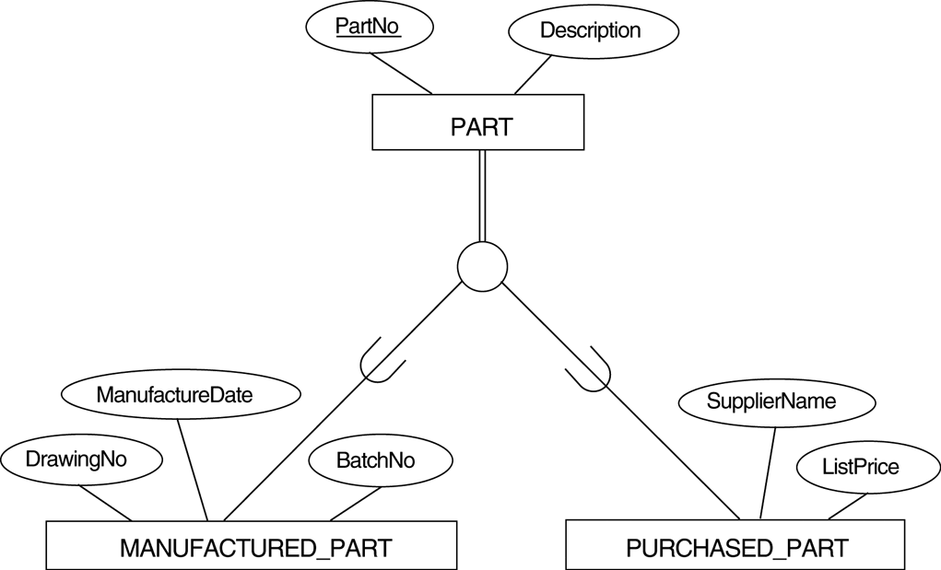
EER-to-Relational Mapping Steps
FIGURE 7.4 – Using Option 8D
O

Slide 55
EER-to-Relational Mapping Steps
Step 9: Mapping of Union Types (Categories).
For mapping a category whose defining super classes have different keys, you can specify a new key attribute, called a surrogate key, when creating a relation to correspond to the category.
Then create a relation for each category, which includes the attributes of the category, and the surrogate key, which acts as the foreign key.
Example:
We can create a relation OWNER to correspond to the OWNER category and include any attributes of the category in this relation. The primary key of the OWNER relation is the surrogate key, which we called OwnerId.

Slide 56
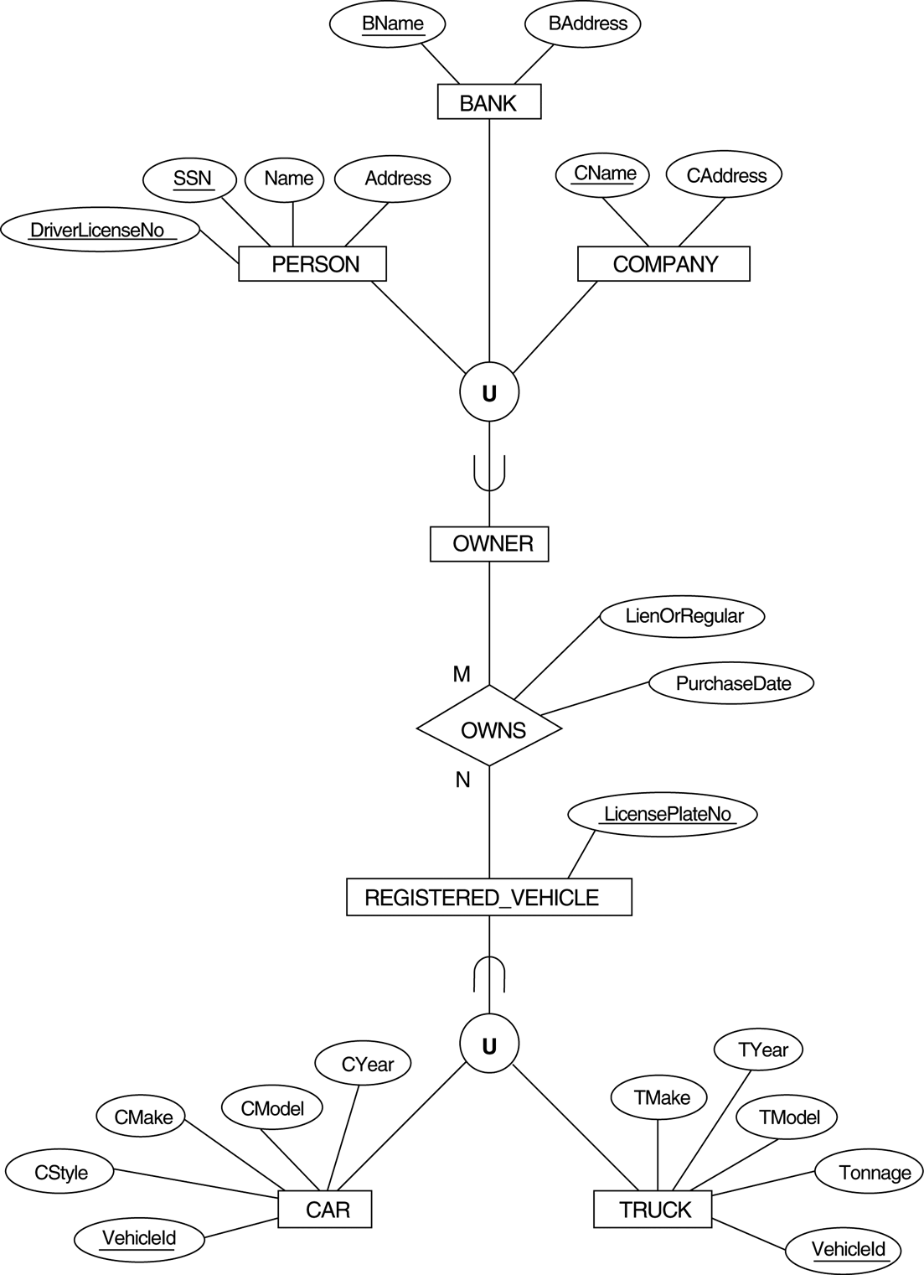
EER-to-Relational Mapping Steps
FIGURE 4.8 Two categories (union types): OWNER and REGISTERED_VEHICLE

Slide 57
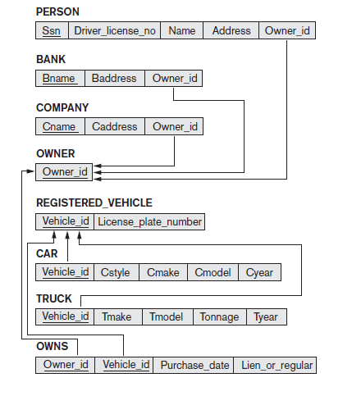
EER-to-Relational Mapping Steps
FIGURE 7.6 Mapping the EER categories (union types) in Figure 4.7 to relations

Slide 58
THANK
YOU

